Slide 1
ICEM Mini Project Group - 5
Group Members :
Adarsh Kumar Singh - 23CE10005 (PPT, Video Dubbing and editing)
Karthikk Kalluri – 23CE10025 (Research)
Priyanshu Verma - 23CE10045 (3D Model, Selection of Software and Planning)
RohitKumar Ramnaresh Meena – 23CE10055 (Manual Sketching)
Shashank Sahil - 23CE10065 (Floor Plan Design)
Vikash Siyak - 23CE10085 (2D Model, Word Doc and Planning)
Surbhi – 22CE10081 (Plan Execution and Project Pdf)

Slide 2

RESIDENTIAL COMPLEX

Slide 3
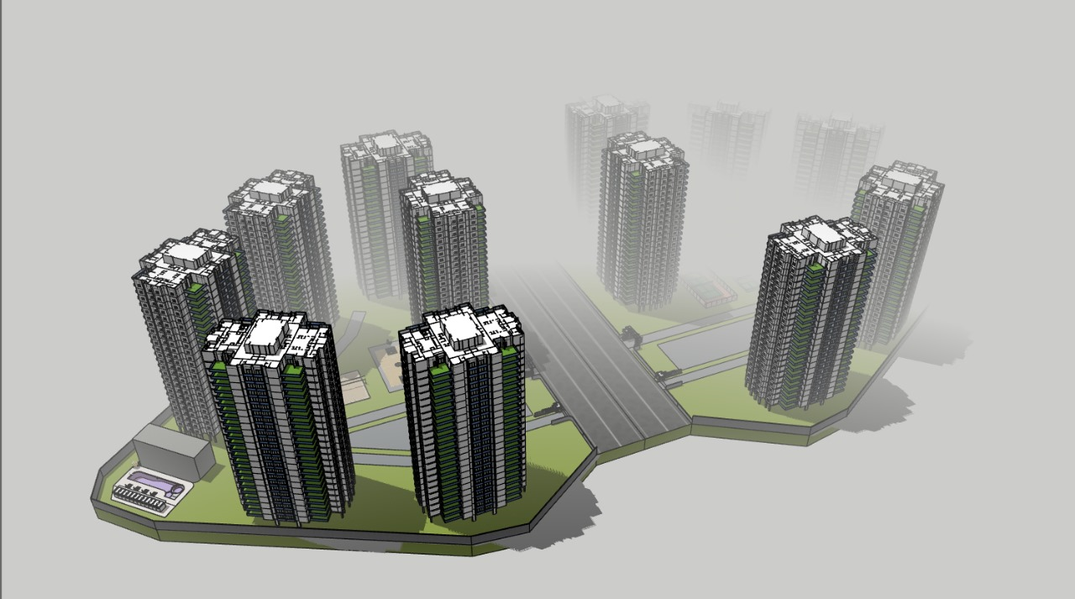

Slide 4
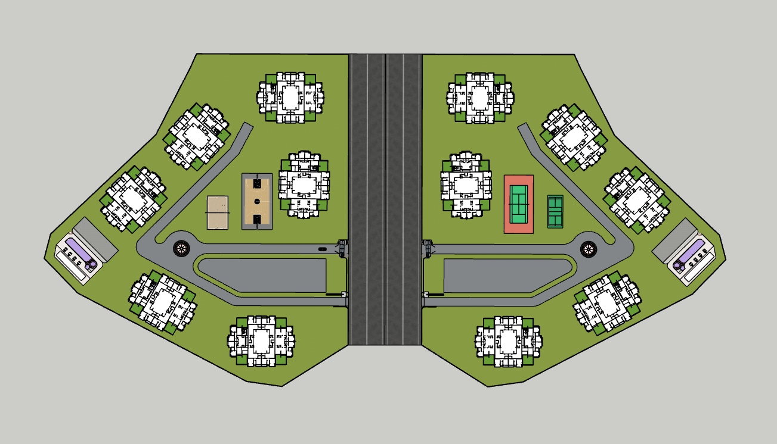
TOWER 5
TOWER 11
TOWER 4
TOWER 10
TOWER 6
TOWER 12
TOWER 3
2
3
TOWER 9
1
4
6
6
5
5
TOWER 2
TOWER 8
TOWER 1
TOWER 7
Volley Ball Court
Basket Ball Court
Tennis Court
Badminton Court
Swimming Pool
Club House with Gym, Indoor games, Library and Movie room

Slide 5
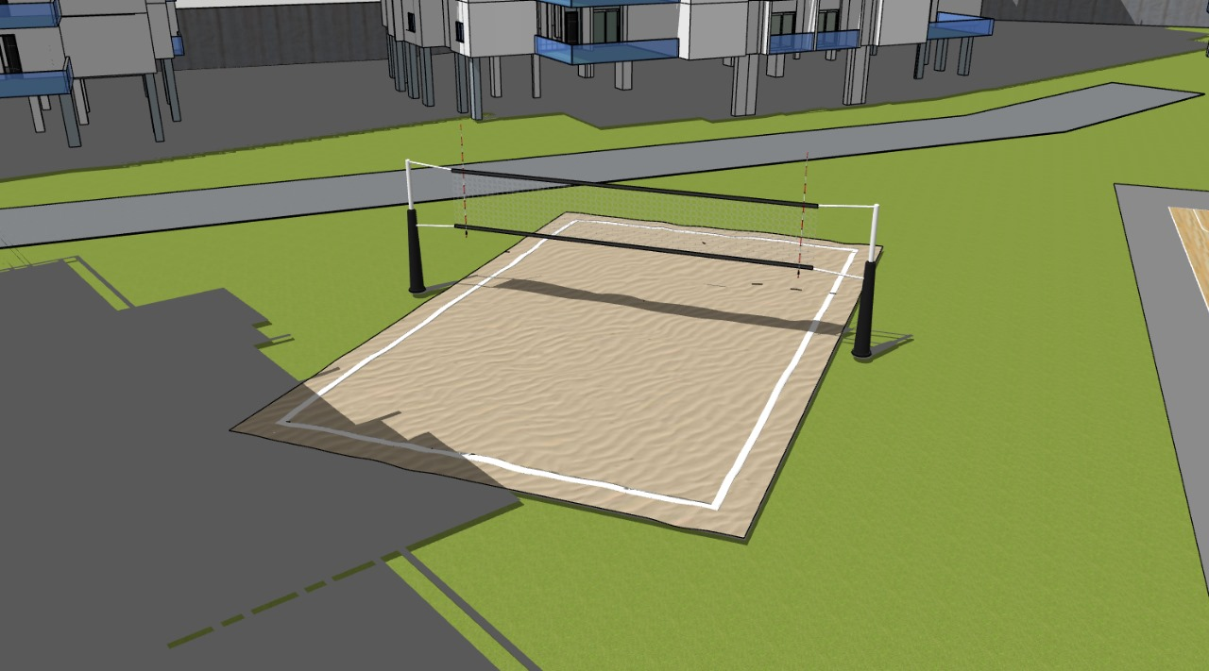
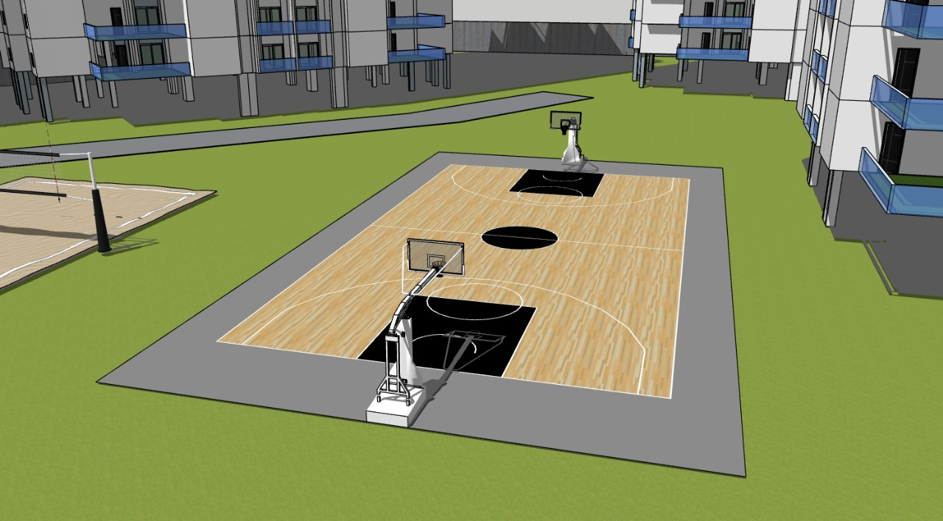
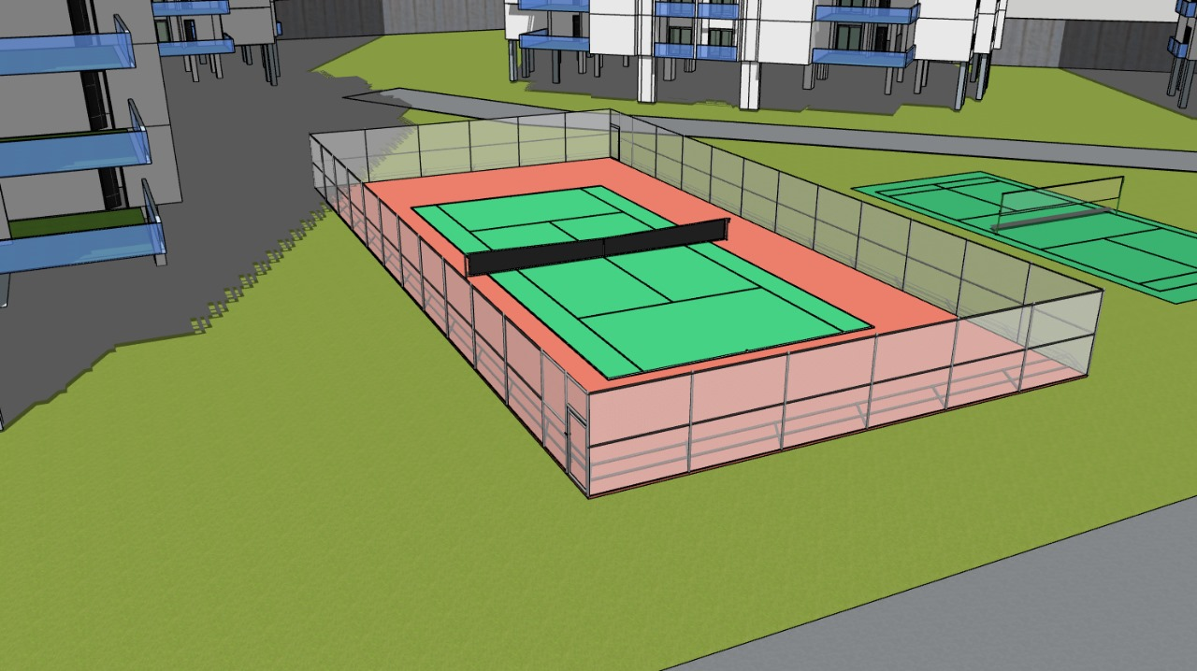
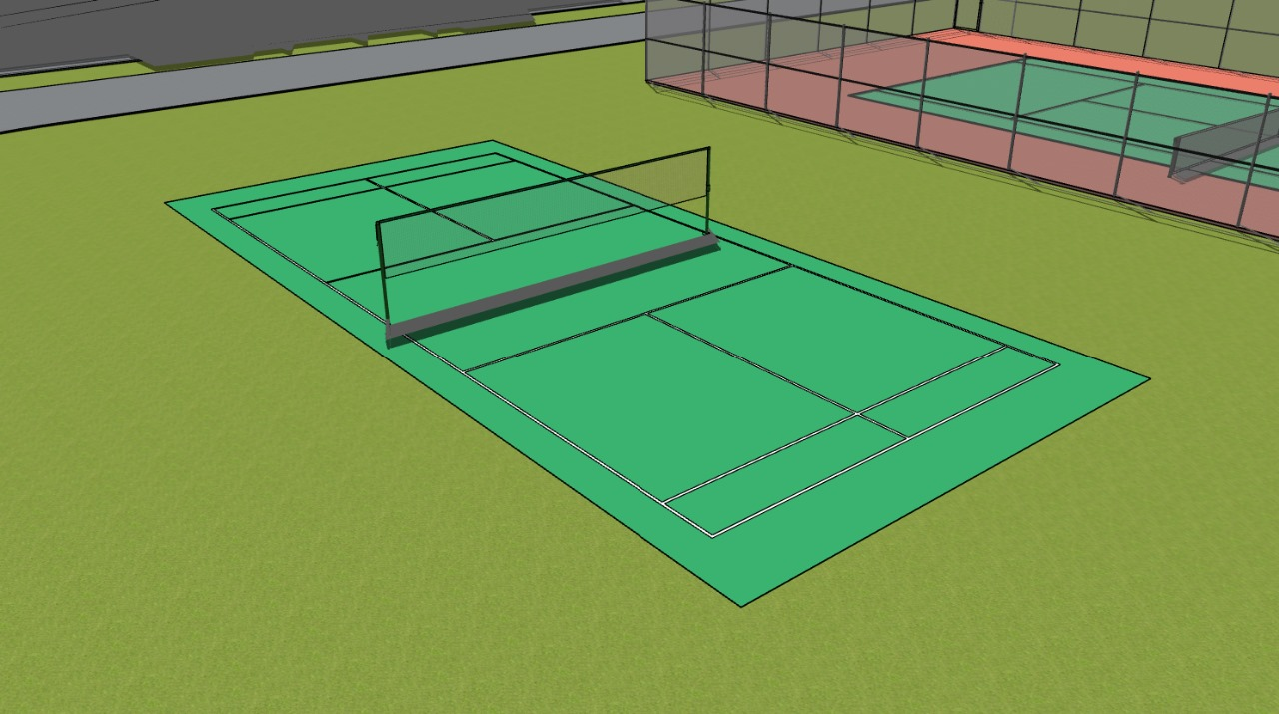
Volley Ball Court
Basket Ball Court
Tennis Court
Badminton Court

Slide 6
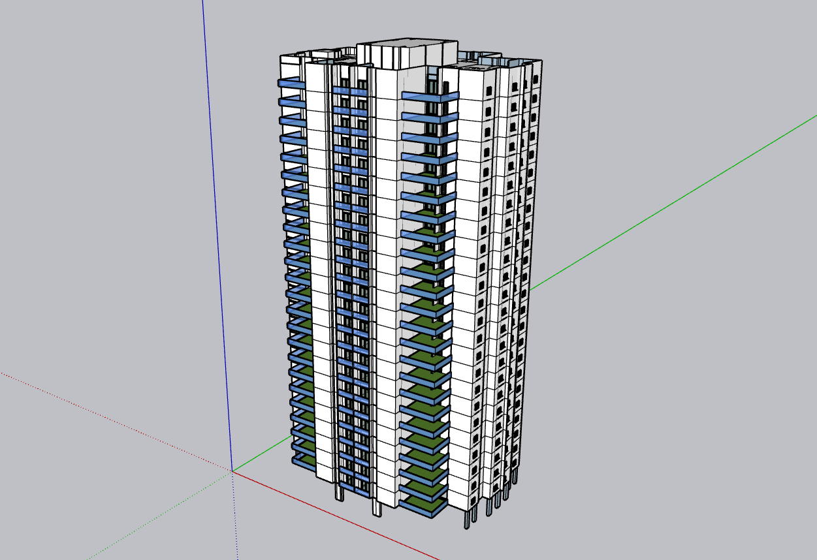

Slide 7
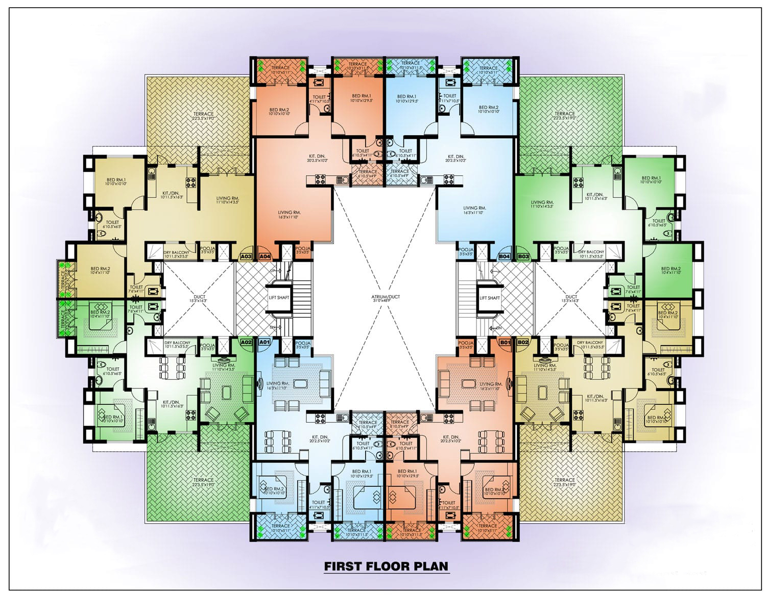
140 x 103 sq.ft

Slide 8
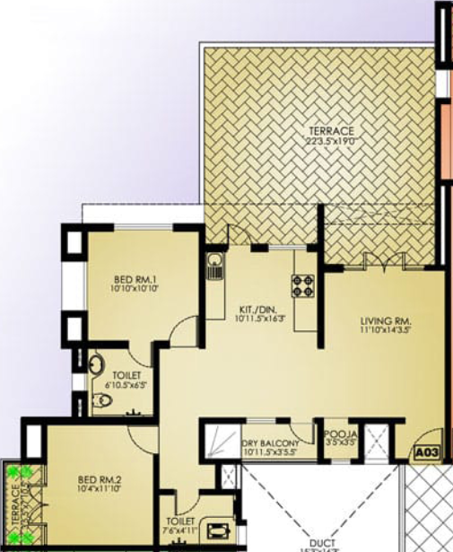

3 BHK
BED RM. 1
BED RM. 2
BED RM. 3
KITCHEN/DINING HALL
POOJA ROOM
TOILET 1
TOILER 2
DRY BALCONY
TERRACE 1
TERRACE 2
10’10” x 10’10”
10’4” x 11’10”
11’10” x 9’3.5”
10’11.5” x 16’3”
3’5” x 3’5”
6’10.5” x 6’5”
7’6” x 4’11”
10’11.5” x 3’5.5”
22’3.5” x 19’0”
3’3.5” x 10’5”

Slide 9
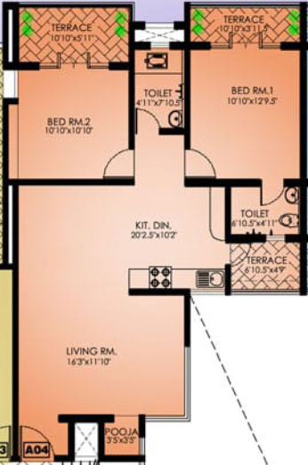




2 BHK
BED RM. 1
BED RM. 2
LIVING ROOM
KITCHEN/DINING HALL
POOJA ROOM
TOILET 1
TOILER 2
TERRACE 1
TERRACE 2
TERRACE 3
10’10” x 12’9.5”
10’10” x 10’10”
16’3” x 11’10”
20’2.5” x 10’2”
3’5” x 3’5”
4’10.5” x 4’11”
4’11” x 7’10.5”
10’10” x 3’11.5”
10’10” x 5’11”
6’10.5” x 4’9”

